Slide 1
Bike Sharing Demand
Presentation by
Sai Pranathi
221FA14061
Notes:
My notes

Slide 2
Agenda
1 | Overall Status
2 | Data Exploration & Data Processing
3 | Linear Regression Model Implementation Results
4 | Analysis of Results & Optimization
5 | Components & Deliverables
6 | Next Steps
7 | Appendix

Slide 3
Background
Project Title
Bike Sharing Demand
Input Data Source
Hourly rental data for two years that contain datetime, season, holiday, workingday, windspeed etc.
Project Goal
Create a machine learning model to forecast bike rental demand by combining historical usages patterns with weather, time and other data. Using this system people will be able to rent a bike from one location and return it to a different location. Use Regression model such as Linear Regression to train, validate and test the tokenized and cleaned up historical data along with the actual number of total rentals.
Technology & Software
Programming Language – R IDE– R Studio

Slide 4
Workflow
Input Data
Obtaining Data
Data file Sources | Kaggle.com
Data file Features | - Hourly rental data spanning two years. - Files are provided in .csv format
Data Exploration
Data Preparation / Curation
Model Building
Model Validation
Model Implementation
Optimization

Slide 5
Hypothesis Generation
Hypothesis which could influence the demand of bike:
Hourly trend: There must be high demand during office timings. Early morning and late evening can have different trend (cyclist) and low demand during 10:00 pm to 4:00 am.
Daily Trend: Registered users demand more bike on weekdays as compared to weekend or holiday.
Rain: The demand of bikes will be lower on a rainy day as compared to a sunny day. Similarly, higher humidity will cause to lower the demand and vice versa.
Temperature: At some location, temperature has negative correlation with bike demand. But, after looking at temperature graph for some other location, I presume it may have positive correlation.

Slide 6
Hypothesis Generation
Pollution: If the pollution level in a city starts soaring, people may start using Bike (it may be influenced by government / company policies or increased awareness).
Time: Total demand should have higher contribution of registered user as compared to casual because registered user base would increase over time.
Traffic: It can be positively correlated with Bike demand. Higher traffic may force people to use bike as compared to other road transport medium like car, taxi etc.

Slide 7
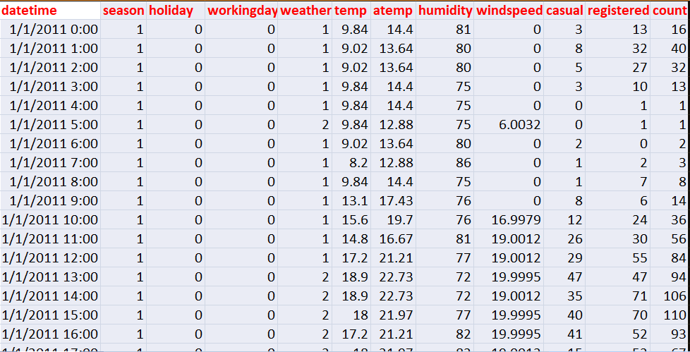
Understanding the Data Set
Data Set Understanding

Slide 8
Understanding the Data Set
Data Set Understanding
The dataset shows hourly rental data for two years (2011 and 2012). The training data set is for the first 19 days of each month. The test dataset is from 20th day to month’s end. We are required to predict the total count of bikes rented during each hour covered by the test set.
In the training data set, we have separately given bike demand by registered, casual users and sum of both is given as count.
Training data set has 12 variables (see below) and Test has 9 (excluding registered, casual and count).

Slide 9
Understanding the Data Set
Independent Variable:
datetime: date and hour in "mm/dd/yyyy hh:mm" format
season: Four categories-> 1 = spring, 2 = summer, 3 = fall, 4 = winter
holiday: whether the day is a holiday or not (1/0)
workingday: whether the day is neither a weekend nor holiday (1/0)
weather: Four Categories of weather
1-> Clear, Few clouds, Partly cloudy
2-> Mist + Cloudy, Mist + Broken clouds, Mist + Few clouds, Mist
3-> Light Snow and Rain + Thunderstorm + Scattered clouds, Light Rain + Scattered clouds
4-> Heavy Rain + Ice Pallets + Thunderstorm + Mist, Snow + Fog
temp: hourly temperature in Celsius
atemp: "feels like" temperature in Celsius
humidity: relative humidity
windspeed: wind speed

Slide 10
Understanding the Data Set
Dependent Variable:
registered: number of registered user season: Four categories-> 1 = spring, 2 = summer, 3 = fall, 4 = winter
casual: number of non-registered user
count: number of total rentals (registered + casual)

Slide 11
Data Exploration
Below are the steps to import and perform data exploration:
Assessment of significance of all data columns and removal of unwanted data columns
Variable Identification
Multivariate Analysis
Missing values treatment
Outlier treatment
Feature Engineering
Identifying data for creating a prototype

Slide 12
Data Exploration
Import Train and Test Data Set
bike_share_train <- read.csv("bike_train.csv", header=T)
bike_share_test <- read.csv(“test.csv", header=T)
Combine both Train and Test Data set
bike_share_test$registered=0
bike_share_test$casual=0
bike_share_test$count=0
data=rbind(bike_share_train, bike_share_test)

Slide 13
Data Exploration
Variable Type Identification
str(data)
'data.frame‘ : 17379 obs. of 12 variables:
$ datetime : Factor w/ 17379 levels "2011-01-01 00:00:00",..: 1 2 3 4 5 6 7 8 9 10 ...
$ season : int 1 1 1 1 1 1 1 1 1 1 ...
$ holiday : int 0 0 0 0 0 0 0 0 0 0 ...
$ workingday : int 0 0 0 0 0 0 0 0 0 0 ...
$ weather : int 1 1 1 1 1 2 1 1 1 1 ...
$ temp : num 9.84 9.02 9.02 9.84 9.84 ...
$ atemp : num 14.4 13.6 13.6 14.4 14.4 ...
$ humidity : int 81 80 80 75 75 75 80 86 75 76 ...
$ windspeed : num 0 0 0 0 0 ...
$ casual : num 3 8 5 3 0 0 2 1 1 8 ...
$ registered : num 13 32 27 10 1 1 0 2 7 6 ...
$ count : num 16 40 32 13 1 1 2 3 8 14 ...

Slide 14
Data Exploration
Find missing values in data set if any
table(is.na(data))
FALSE
208548
Above we can see that it has returned no missing values in the data frame.

Slide 15
Data Exploration
Distribution of numerical variables and generate a frequency table for numeric variables. Now, We’ll test and plot a histogram for each numerical variables and analyze the distribution.
hist(bike_share_train$count)
hist(as.numeric(bike_share_train$season))
hist(as.numeric(bike_share_train$weather))
hist(bike_share_train$humidity)
hist(as.numeric(bike_share_train$holiday))
hist(as.numeric(bike_share_train$workingday))
hist(as.numeric(bike_share_train$temp))
hist(as.numeric(bike_share_train$atemp))
hist(as.numeric(bike_share_train$windspeed))

Slide 16
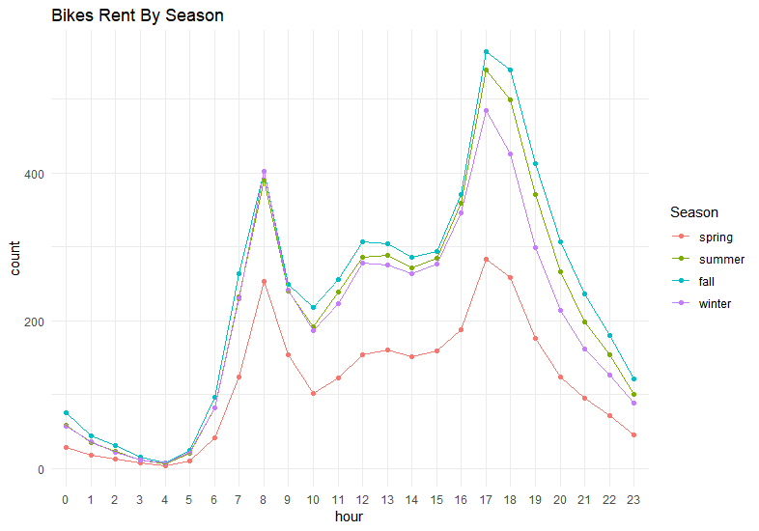
Data Exploration

Slide 17
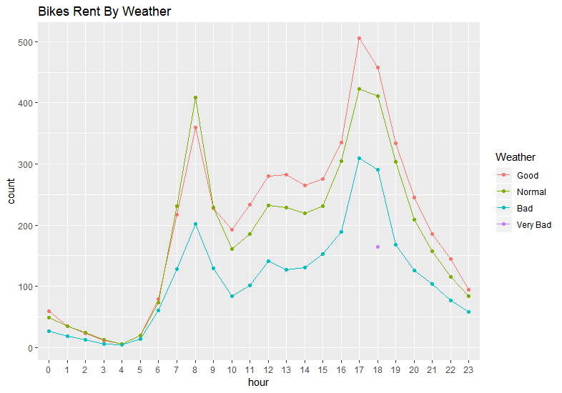
Data Exploration

Slide 18
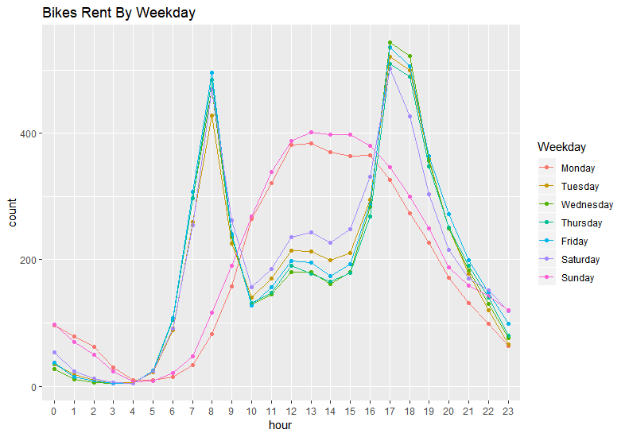
Data Exploration

Slide 19
Data Exploration
Few inferences can be drawn by looking at the these histograms:
Season has four categories of almost equal distribution
Weather 1 has higher contribution i.e. mostly clear weather.
As expected, mostly working days and variable holiday is also showing a similar inference.
Variables temp, atemp, humidity and windspeed looks naturally distributed.
The bike rentals can be segregated into three categories:
1. High : 8:00-10:00 and 17:00-20:00
2. Average : 10:00-16:00
3. Low : 0:00-6:00 and 20:00-24:00

Slide 20
Hypothesis Testing
Using multivariate analysis:
Till now, we have got a fair understanding of the data set. Now, let’s test the hypothesis which we had generated earlier. Here we have added some additional hypothesis from the dataset. Let’s test them one by one:
Hourly trend: We don’t have the variable ‘hour’ with us right now. But we can extract it using the datetime column.
data$hour=substr(data$datetime,12,13)
data$hour=as.factor(data$hour)
Let’s plot the hourly trend of count over hours and check if our hypothesis is correct or not. We will separate train and test data set from combined one.
train=data[as.integer(substr(data$datetime,9,10))<20,] test=data[as.integer(substr(data$datetime,9,10))>19,] boxplot(train$count~train$hour,xlab="hour", ylab="count of users")

Slide 21
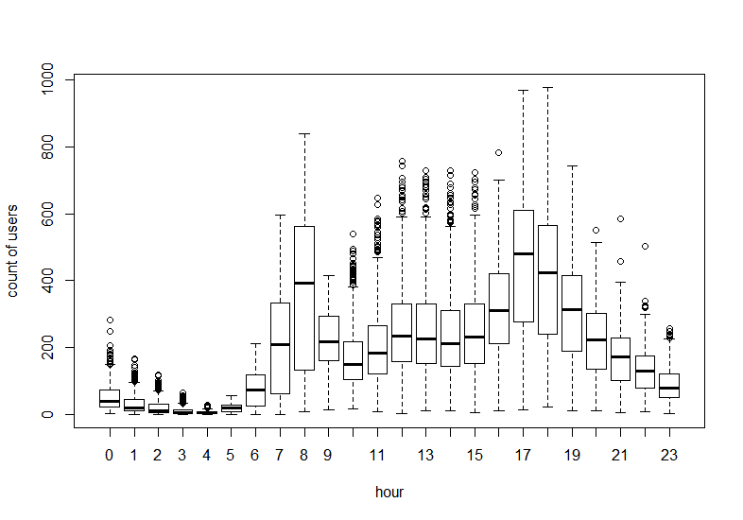
Hypothesis Testing
Here we can see the trend of bike demand over hours. We’ll segregate the bike demand in three categories:
High : 7-9 and 17- 19 hours
Average : 10-16 hours
Low : 0-6 and 20-24 hours

Slide 22
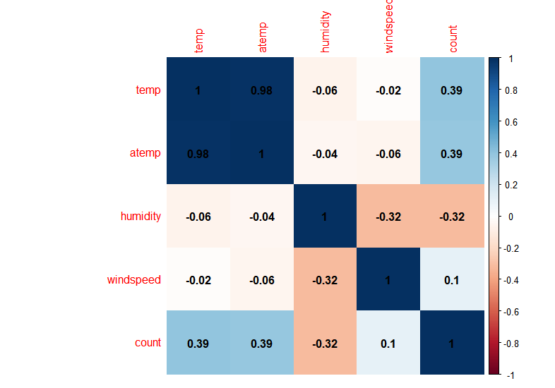
Hypothesis Testing
Correlation Analysis
Correlation plot between fields
It shows that temp, atemp has much correlation.

Slide 23
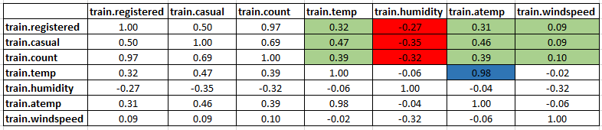
Hypothesis Testing
Temperature, Windspeed and Humidity: These are continuous variables so we can look at the correlation factor to validate hypothesis.
Here are a few inferences you can draw by looking at the above histograms:
Variable temp is positively correlated with dependent variables (casual is more compare to registered)
Variable atemp is highly correlated with temp.
Windspeed has lower correlation as compared to temp and humidity.

Slide 24
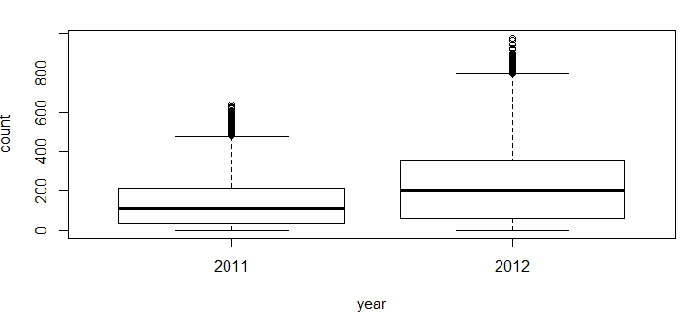
Hypothesis Testing
Time: Let’s extract year of each observation from the datetime column and see the trend of bike demand over year.
You can see that 2012 has higher bike demand as compared to 2011.

Slide 25
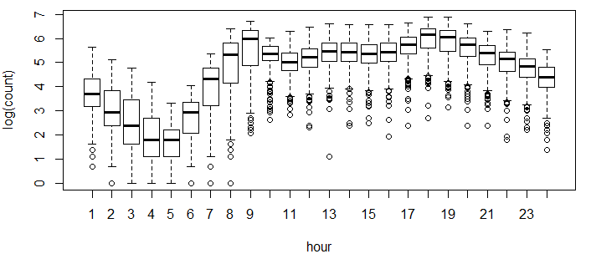
Hypothesis Testing
There are a lot of outliers while plotting the count of registered and casual users. These values are not generated due to error, so we consider them as natural outliers. They might be a result of groups of people taking up cycling (who are not registered). To treat such outliers, we will use logarithm transformation. Let’s look at the similar plot after log transformation.

Slide 26
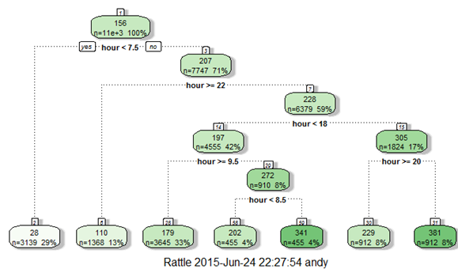
Feature Engineering
In addition to existing independent variables, we will create new variables to improve the prediction power of model. Initially, we must have noticed that we generated new variables like hour, month, day and year.
Here we will create more variables, let’s look at the some of these:
Hour Bins: Initially, we have broadly categorize the hour into three categories. Let’s create bins for the hour variable separately for casual and registered users. Here we will use decision tree to find the accurate bins.

Slide 27
Feature Engineering
Now, looking at the nodes we can create different hour bucket for registered users.
data=rbind(train,test)
data$dp_reg=0
data$dp_reg[data$hour<8]=1
data$dp_reg[data$hour>=22]=2
data$dp_reg[data$hour>9 & data$hour<18]=3
data$dp_reg[data$hour==8]=4
data$dp_reg[data$hour==9]=5
data$dp_reg[data$hour==20 | data$hour==21]=6
data$dp_reg[data$hour==19 | data$hour==18]=7
Similarly, we can create day_part for casual users also (dp_cas).

Slide 28
Feature Engineering
Temp Bins: Using similar methods, we have created bins for temperature for both registered and casuals users. Variables created are (temp_reg and temp_cas).
Year Bins: We had a hypothesis that bike demand will increase over time and we have proved it also. Here I have created 8 bins (quarterly) for two years. Jan-Mar 2011 as 1 …..Oct-Dec2012 as 8.
Day Type: Created a variable having categories like “weekday”, “weekend” and “holiday”.
Weekend: Created a separate variable for weekend (0/1)

Slide 29
Model Creation
Model Creation
We have applied Linear Regression Algorithm.
Approach –
Create a prototype model for the Bike sharing data best fit for training in the data-exploration phase
Validate and test the model using on the same dataset
Test the model on test dataset
Measure the accuracy of the results
Re-train the model based on observations until the accuracy improves

Slide 30
Model Validation
Model Validation
We will be validating our model and tuning the hyperparameters using a 10 fold cross validation. We randomly shuffled our data set and used ⅓ of the data points as test set. We partitioned the remaining data set into 10 splits. In each of the 10 iterations we trained our model on 9 splits and calculated the RMSLE on the remaining split. On the basis of the average of 10 RMSLEs, we tuned our hyper parameters. After tuning the hyperparameters, we trained the model on the complete data set and evaluated the model on the test set. Thus, 10 fold cross validation was used to prevent overfitting.

Slide 31
Next Step:
Further Optimization Area
In future work we would like to add some more covariates and improve the predictions. We can also do hourly predictions between each pair of stations. This prediction task may further help the Bike sharing company to do strategic management at more granular level.
Some of the covariates that we could think of integrating in future are:
● Taxi and subway data: We suspect that there could be a positive correlation between demand for short taxi rides within an area and demand for bikes in that area. The presence of subway station near a bike station may also increase the demand for bikes at that particular station.
● Restaurant and retail shop data: If there are a lot of restaurants and retail shop in an area, the number of customers visiting these places may have a positive correlation with the bike demand in the same area.

Slide 32
Next Step:
Further Optimization Area
Some of the different models that could be tried in future are:
● Time series analysis using models such as ​autoregressive integrated moving average (ARIMA), Microsoft’s time series algorithm, ARXTP (autoregressive tree-models with cross prediction).
● Neural network algorithms like LSTM, MLP regression.

Slide 33
Conclusion
Conclusion
We established significant relationship between several independent variables and Bike sharing ridership.
We developed a regression model that can be applied directly to bike station business to predict hourly demand.
We also found that the usage of bike rental is far more high for registered users as compared to casual user
And the demand is maximum during morning and evening travel hours.
Also weather has significant effect on bike ridership. A clear and sunny weather invites more riders as compared to rainy and snow weather.

Slide 34
Thank You.

